Slide 2
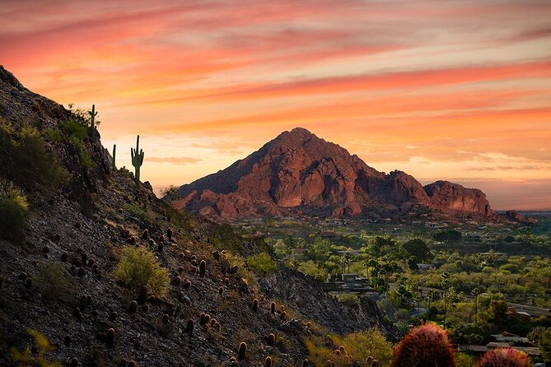
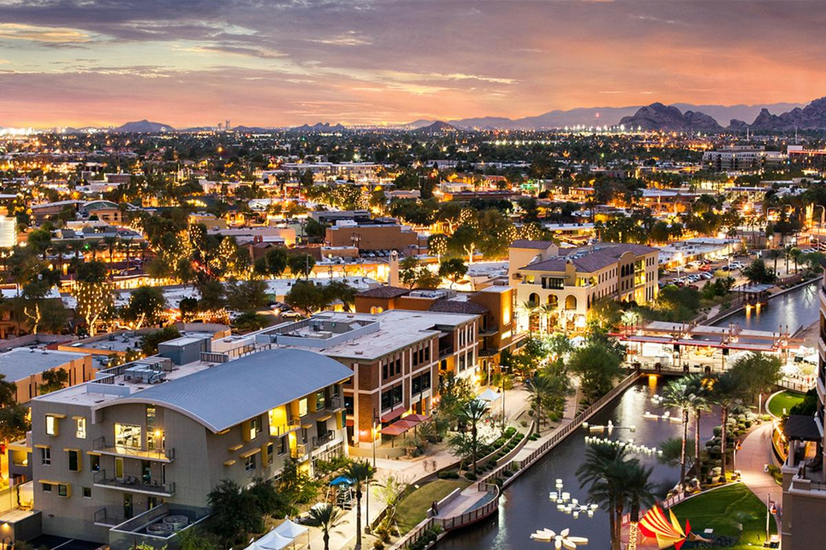
THE LOCATION
// Downtown Scottsdale (Old Town)
Major crossroads of Scottsdale and Camelback
// Airports – 8 miles from Hotel
Main Airport - PHX Sky Harbor
Private Planes – Scottsdale Airport
// Endless Shopping Experience
Hotel located adjacent to Fashion Square Mall & District
Over 240 shopping destinations
// Restaurants & Nightlife
Over 80 dining options available less than 3 blocks from Hotel

Slide 3
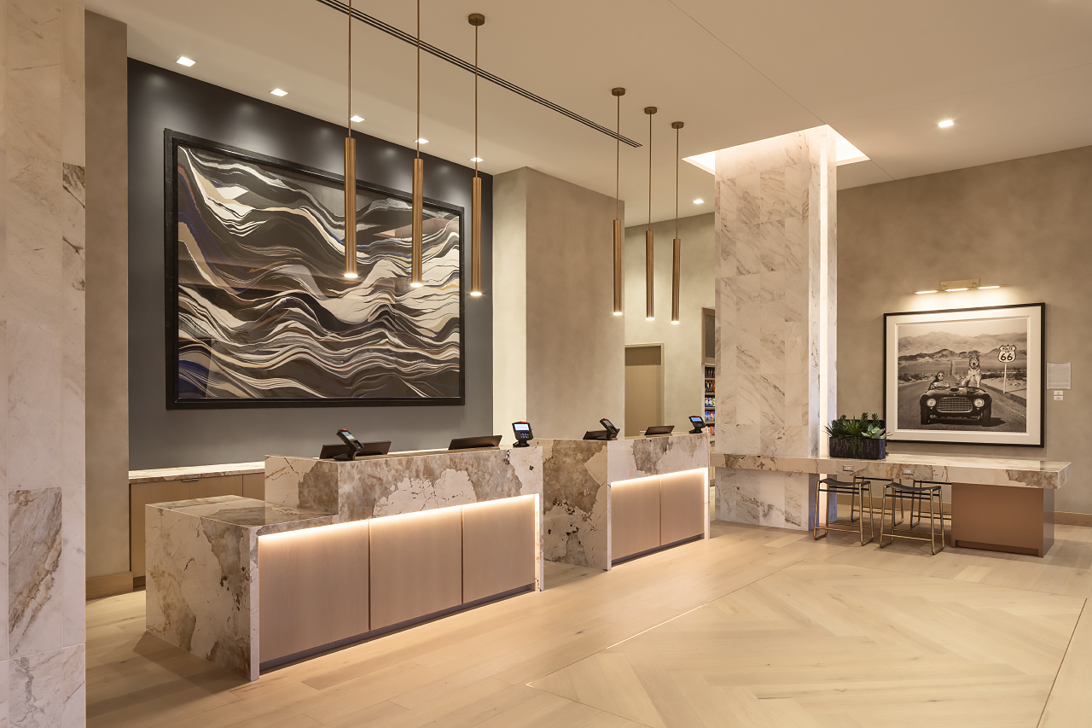

Slide 4
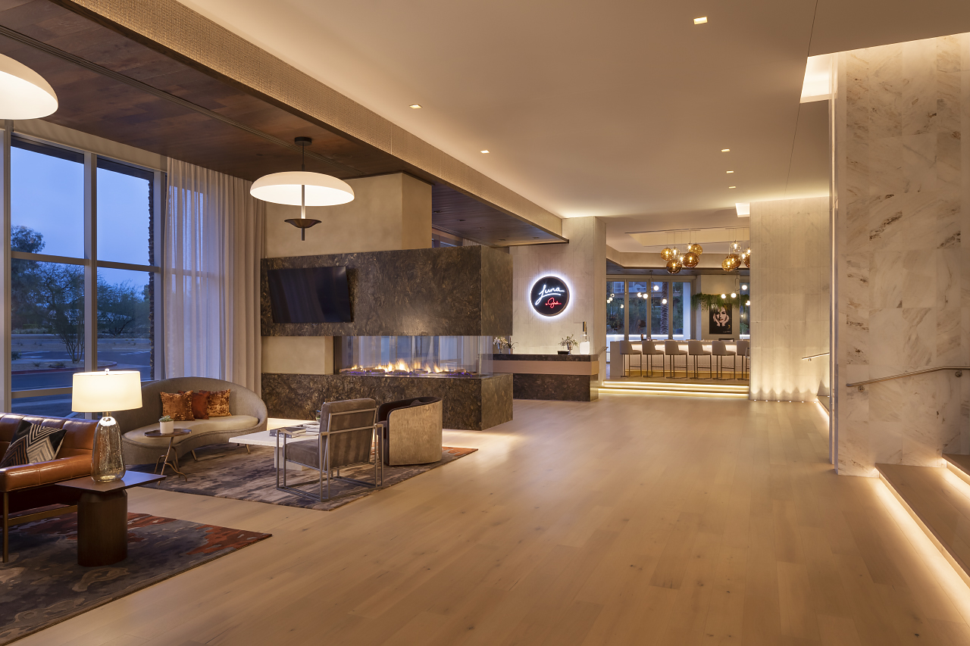

Slide 5
FACT SHEET
// HOTEL AMENITIES
265 guestrooms & suites
33 suites including five (5) 2,000sf luxury suites
1 Bridal Suite
LUNA - Signature restaurant by Giada De Laurentiis
SEVEN - Rooftop pool & lounge overlooking Camelback Mountain
Pronto - All day café bistro
Complimentary Access to 24 Hour Fitness Center
EV Charging Stations
Use of Hotel Electric Bicycles
Complimentary access to Wellness Events on property

Slide 6
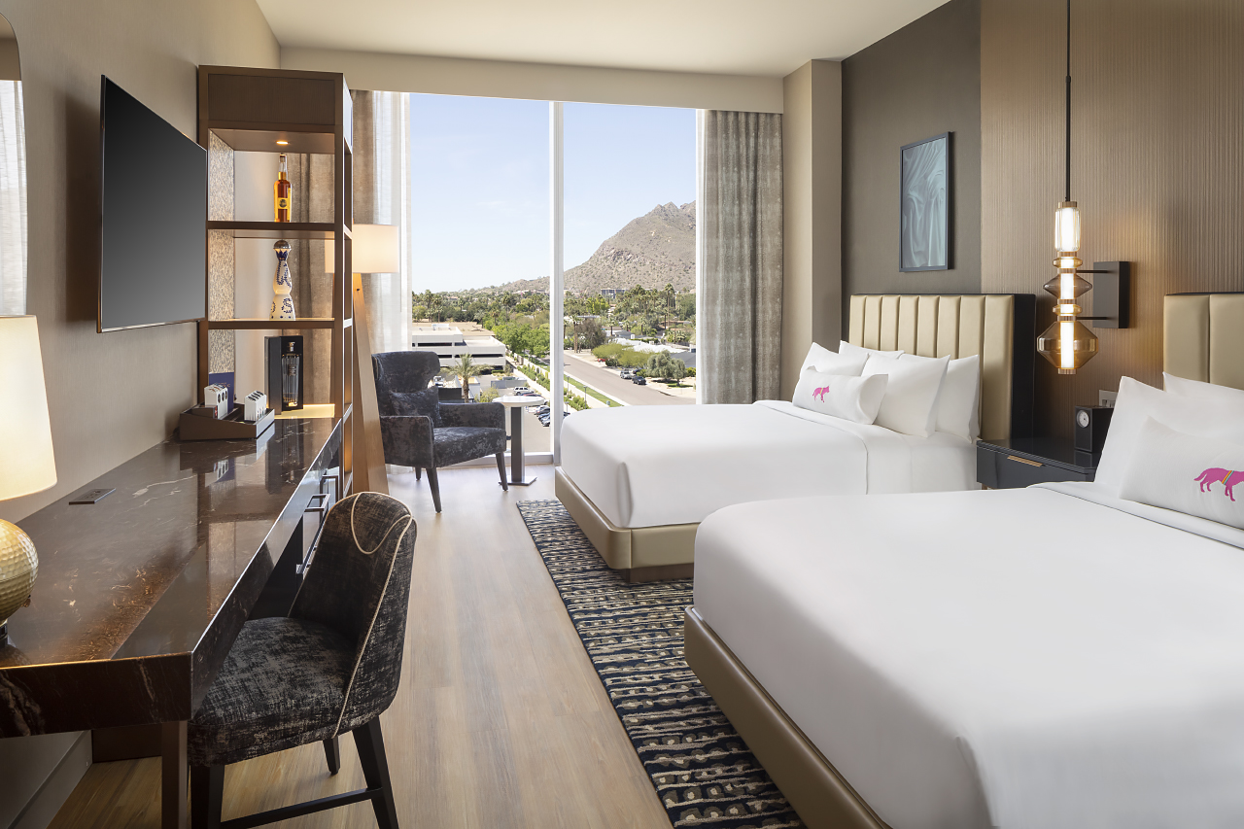

Slide 7
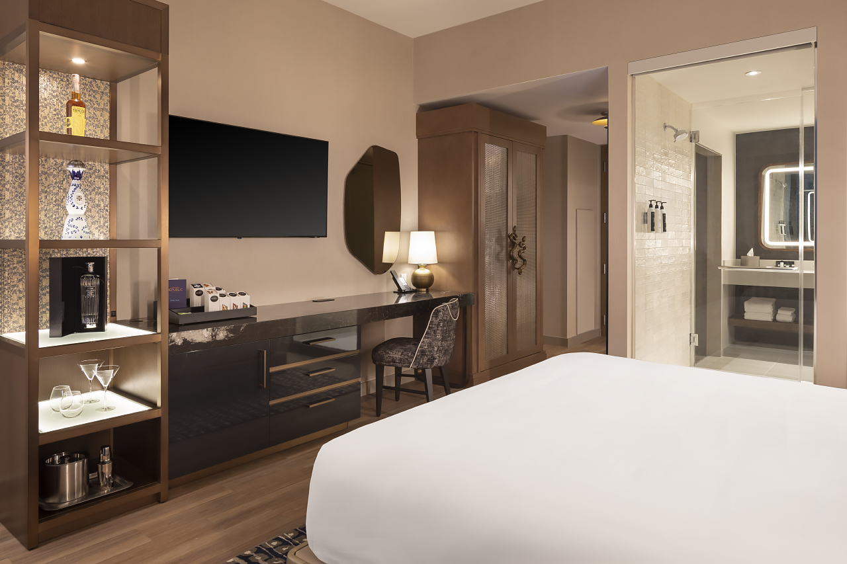

Slide 8
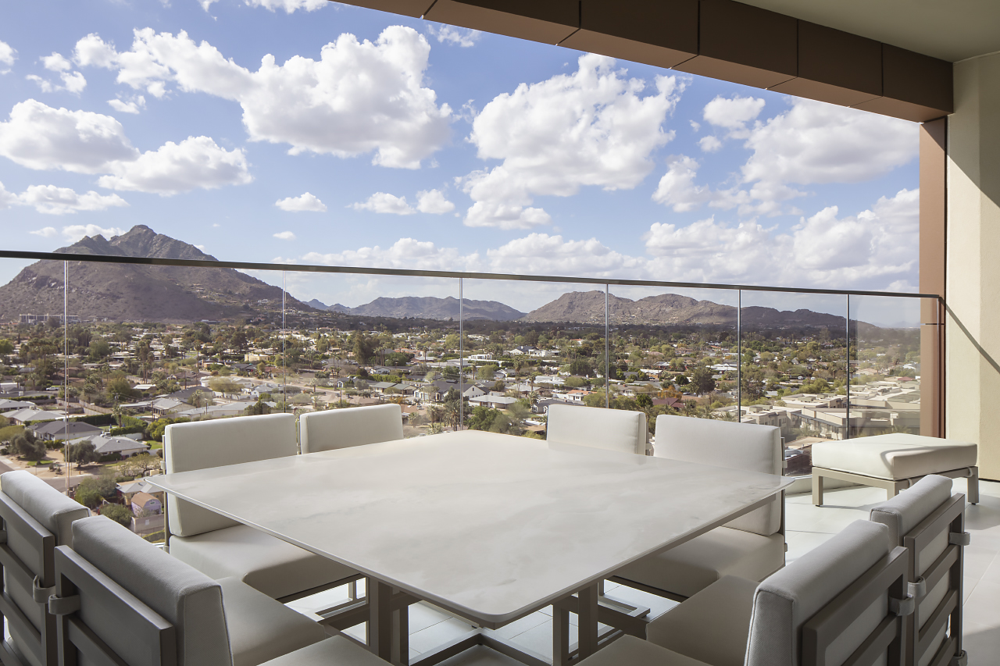

Slide 9
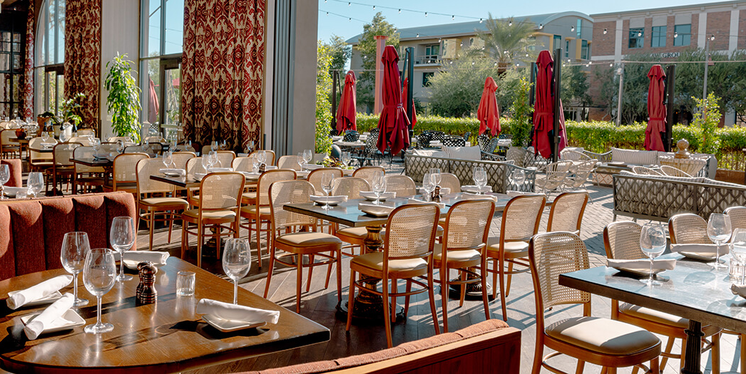
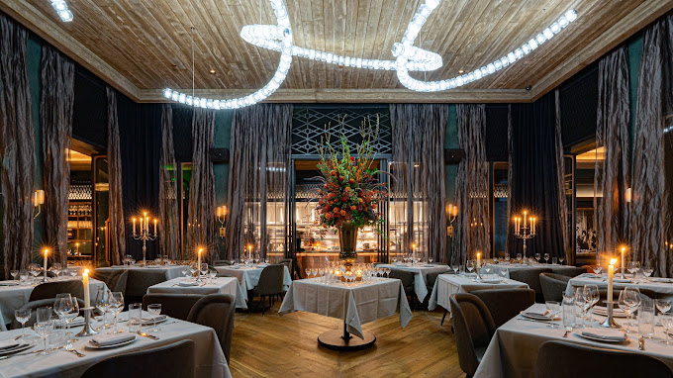
DINE AROUND THE CITY
One of our greatest advantages is our location in Scottsdale’s Fashion Square District. For groups, you are not limited to our restaurants and venues on property. There are over 80 dining options less than 3 blocks from our doorstep. We recommend the following options for our groups which are all within walking distance:
Ocean 44
Toca Madera
Nobu Scottsdale
Olive & Ivy
Mastro’s City Hall
Maple & Ash
Culinary Dropout
Hand Cut

Slide 10
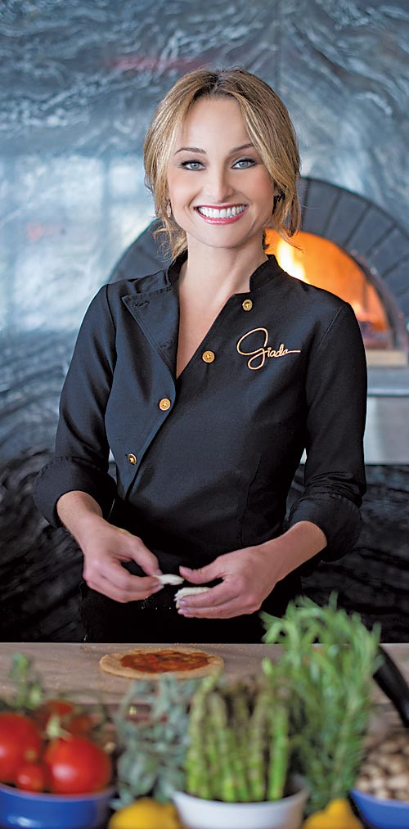
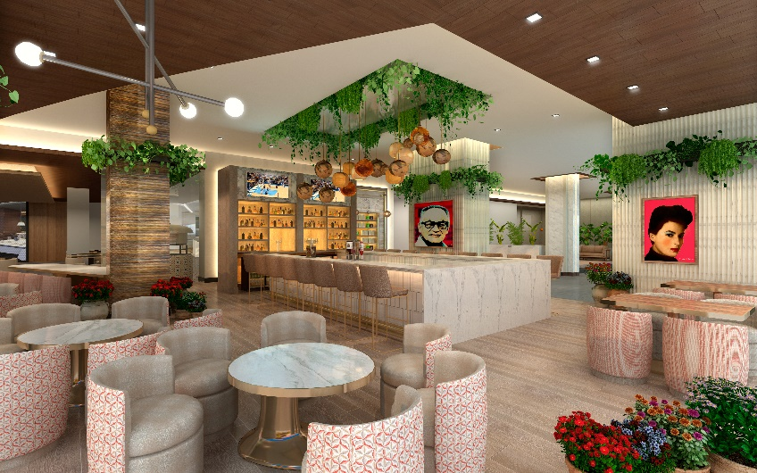
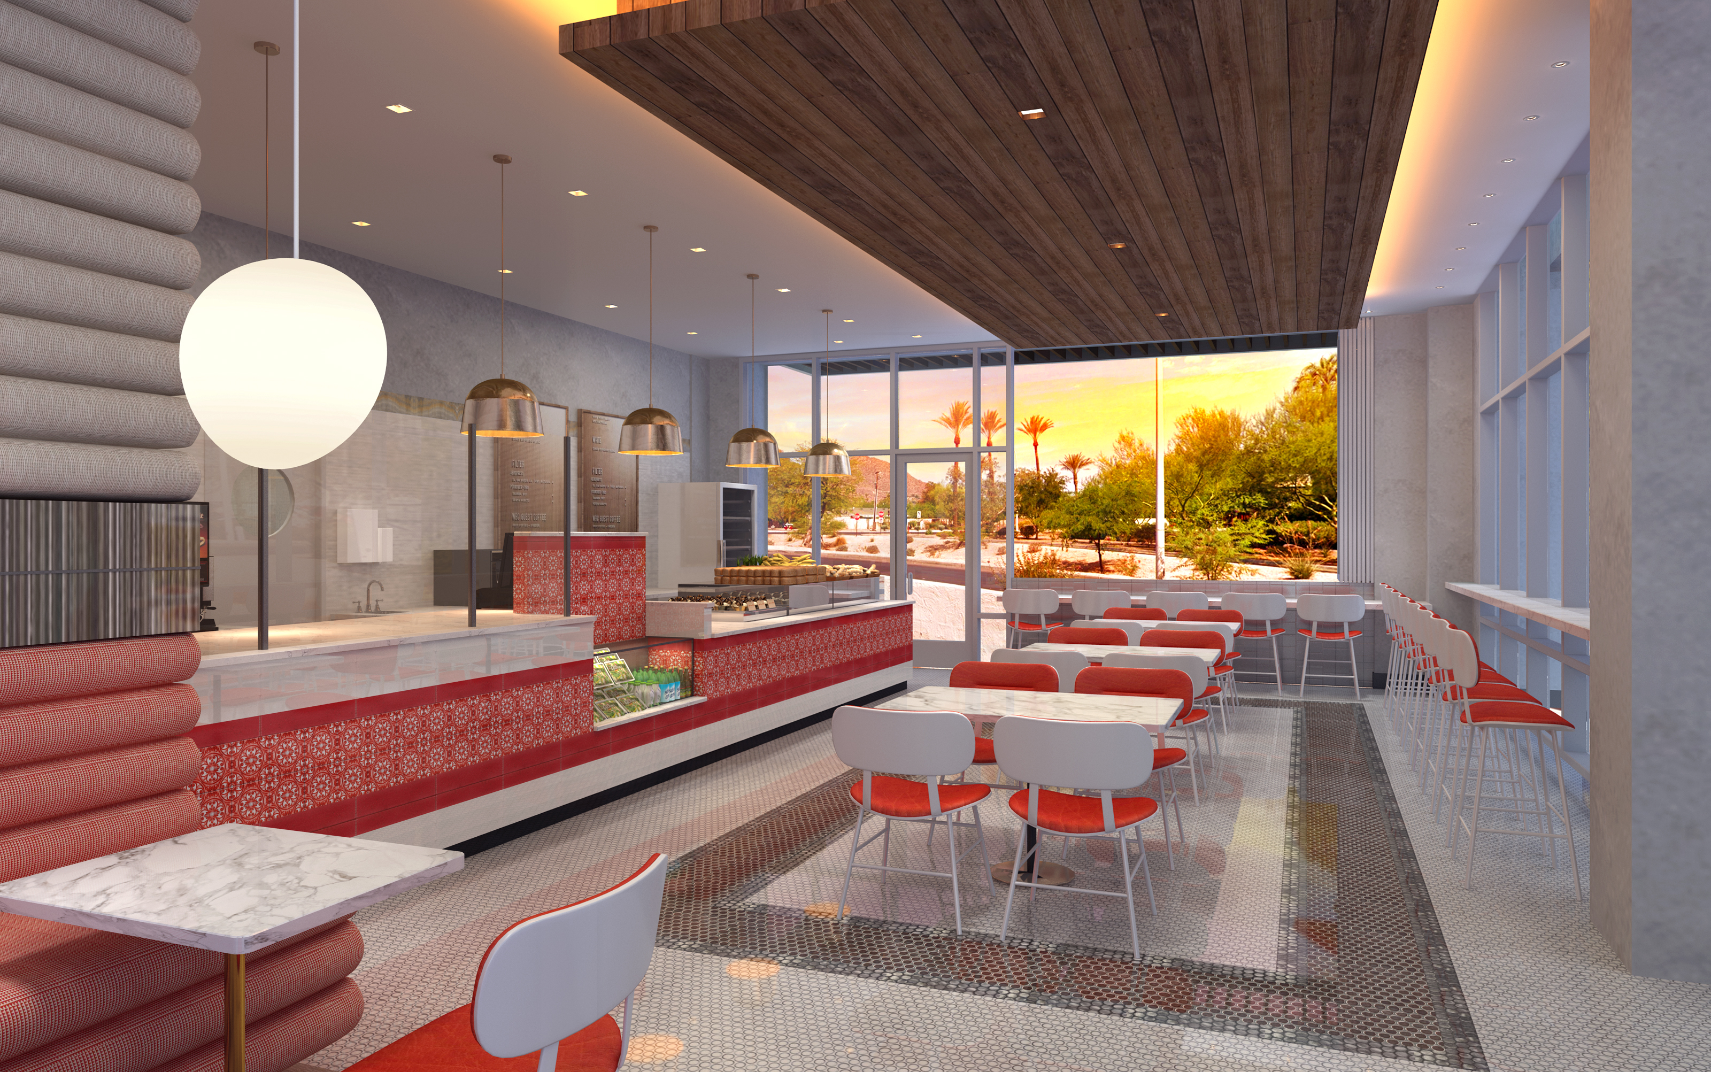
GIADA DE LAURENTIIS
LUNA by Giada
Celebrated chef, author, philanthropist and television personality Giada De Laurentiis will be opening a brand new concept, Luna by Giada. The signature restaurant will be a sophisticated, high-energy environment featuring Giada’s esquisite Italian cooking with vibrant, California influences
PRONTO by Giada
Also developed by Giada De Laurentiis, Pronto, will be the hotel’s all day café bistro featuring Italian fare in fast casual format

Slide 11
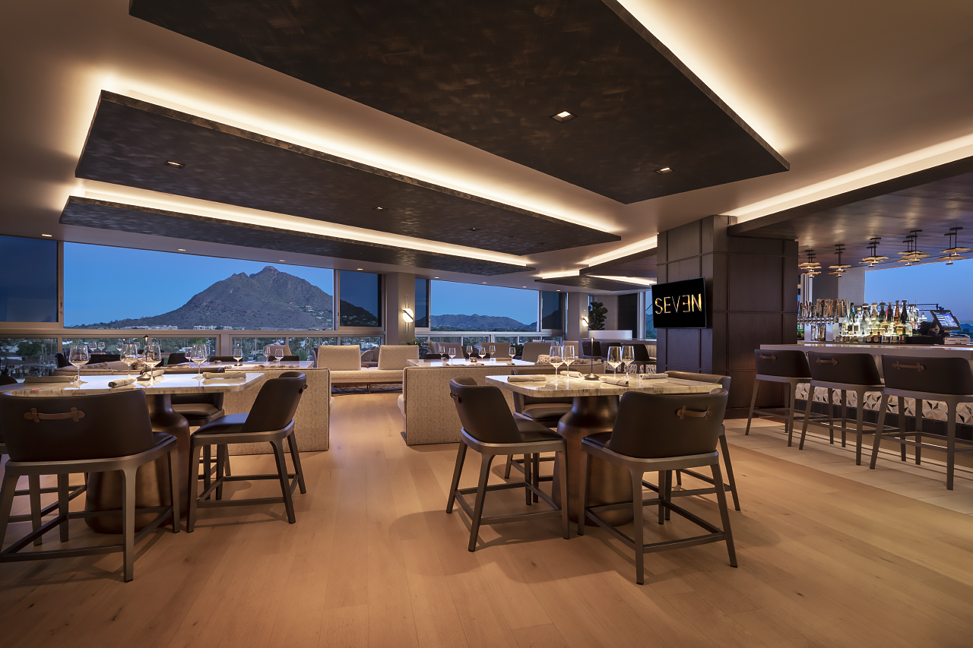

Slide 12
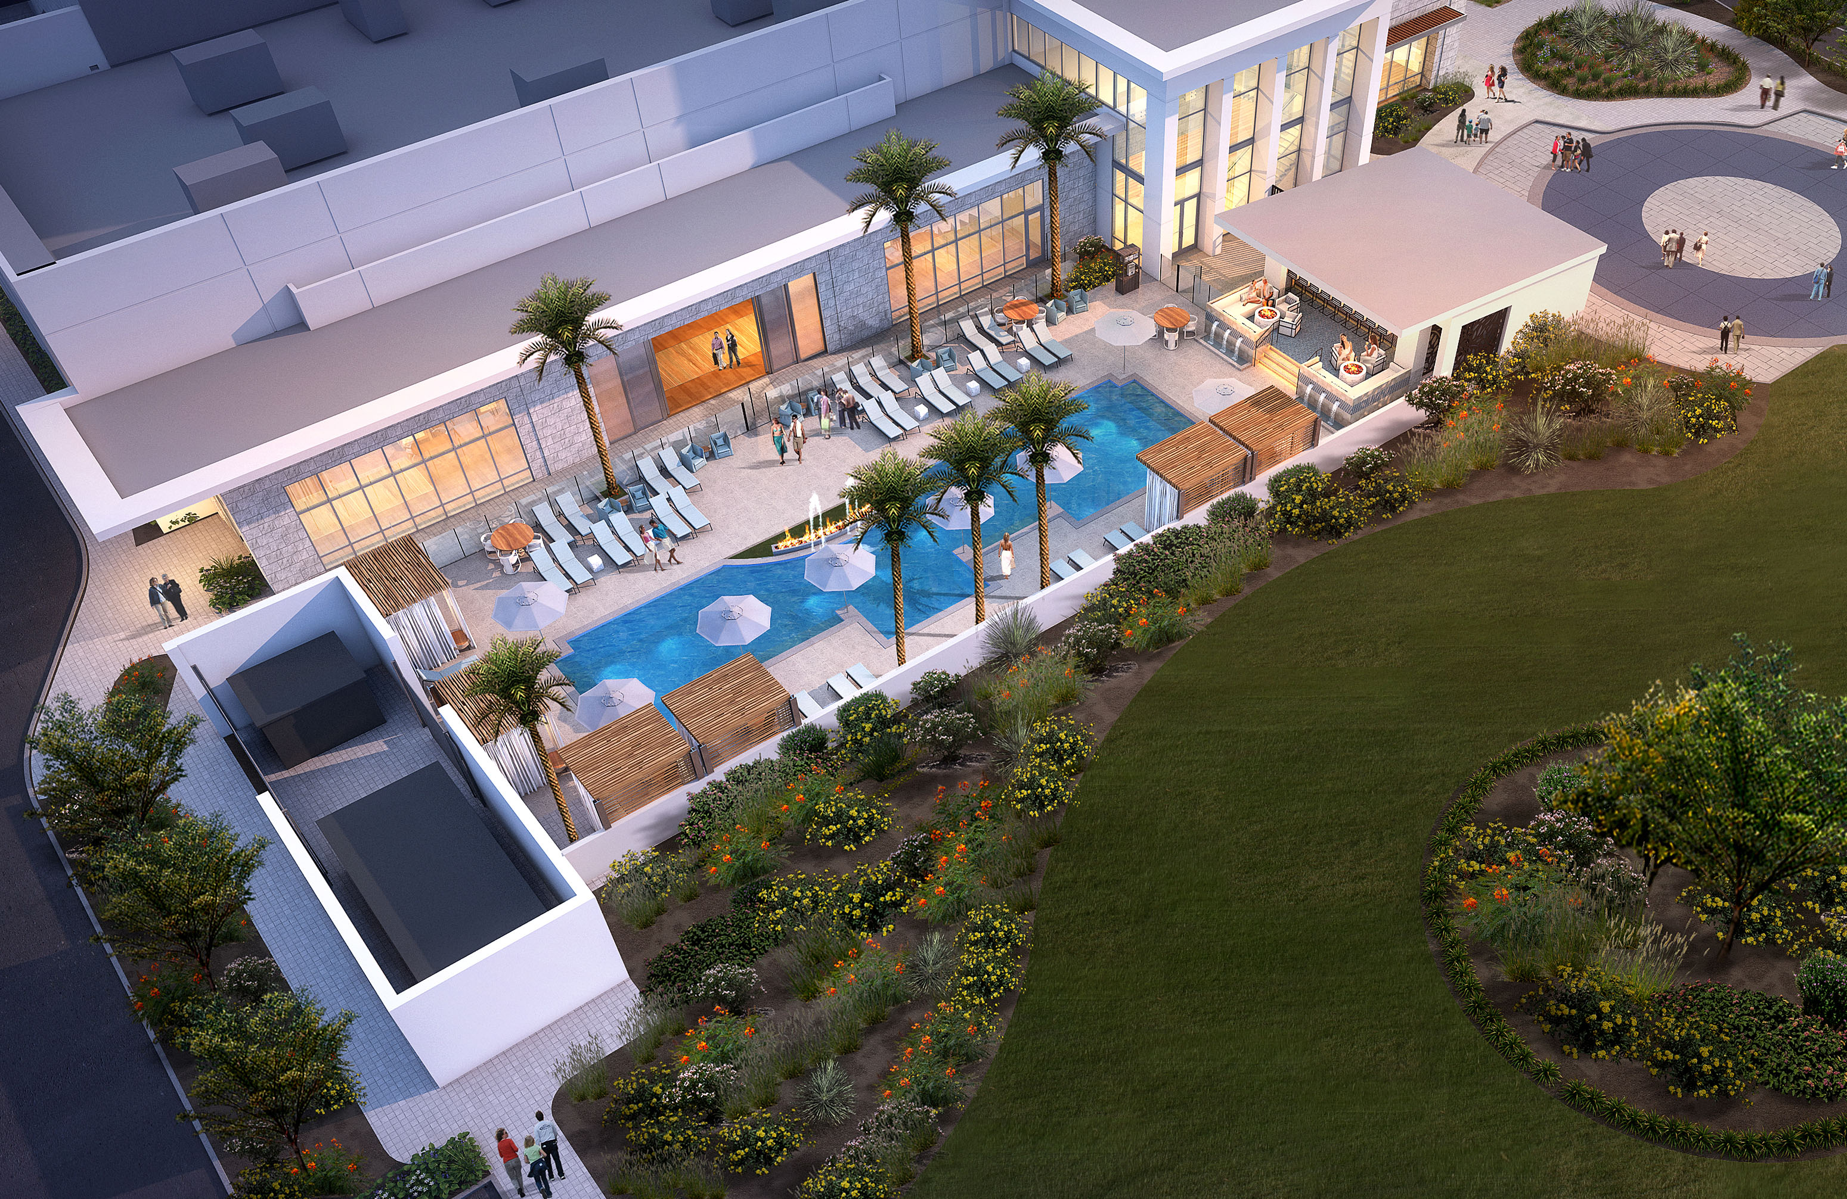
MEETING SPACE
With over 20,000 square feet of event space, including more than 10,000 square feet of meeting space, Caesars Republic Scottsdale can accommodate group events from 10 to 1,500 attendees.
Meeting Space
7,000sf ballroom with 20 foot ceilings
Six (6) breakout rooms (650sf each)
One (1) boardroom with seating up to 16 attendees
Two (2) private dining rooms with seating up to 30 attendees
Event Space
Cleopatra Pool and Event Space (private)
Camelback Veranda (private)

Slide 14
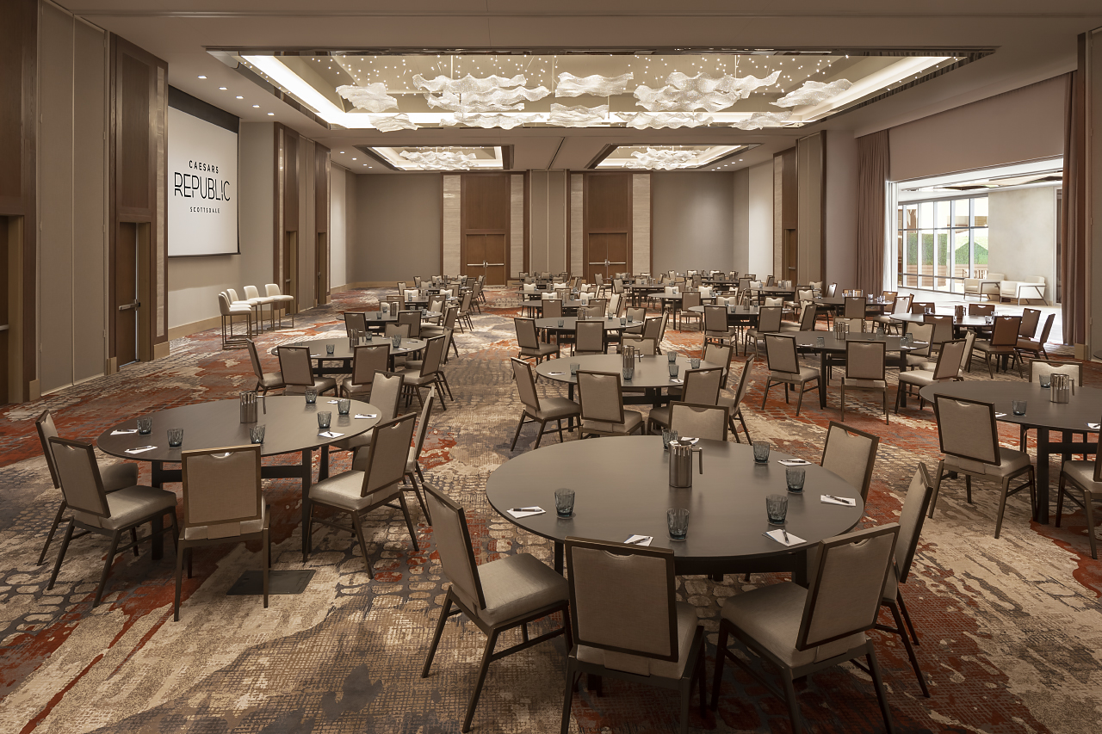

Slide 15
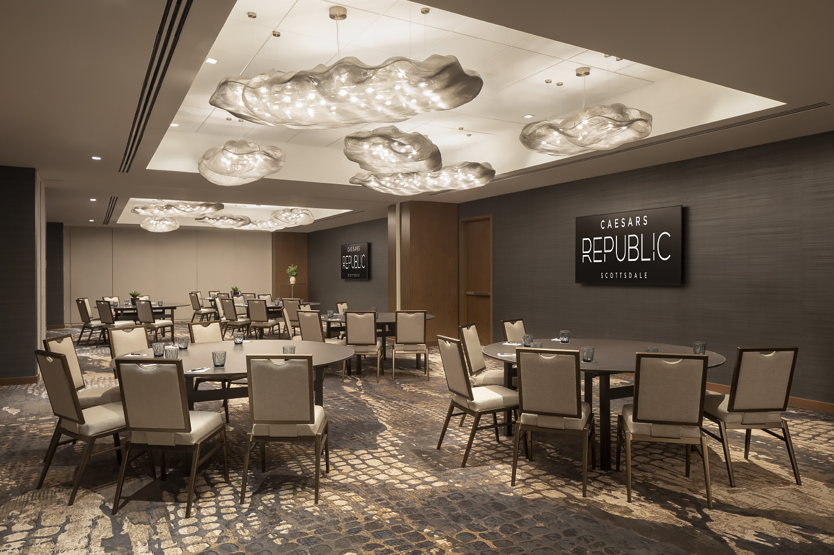

Slide 16
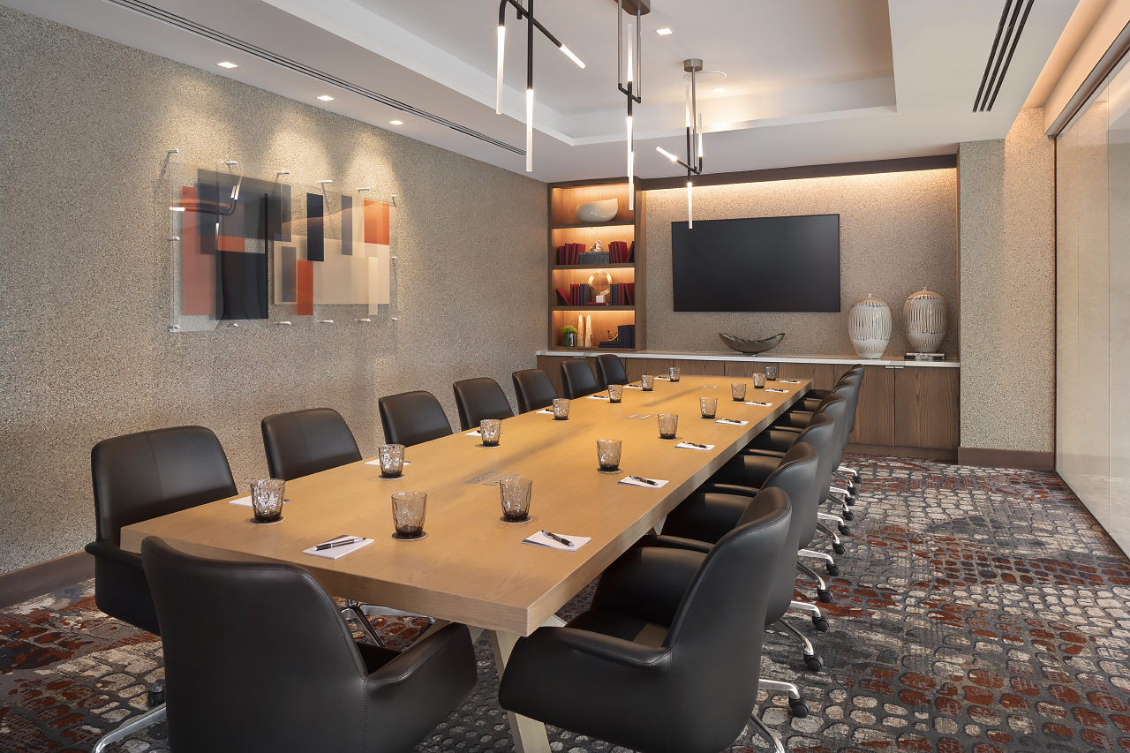

Slide 17
