Slide 1
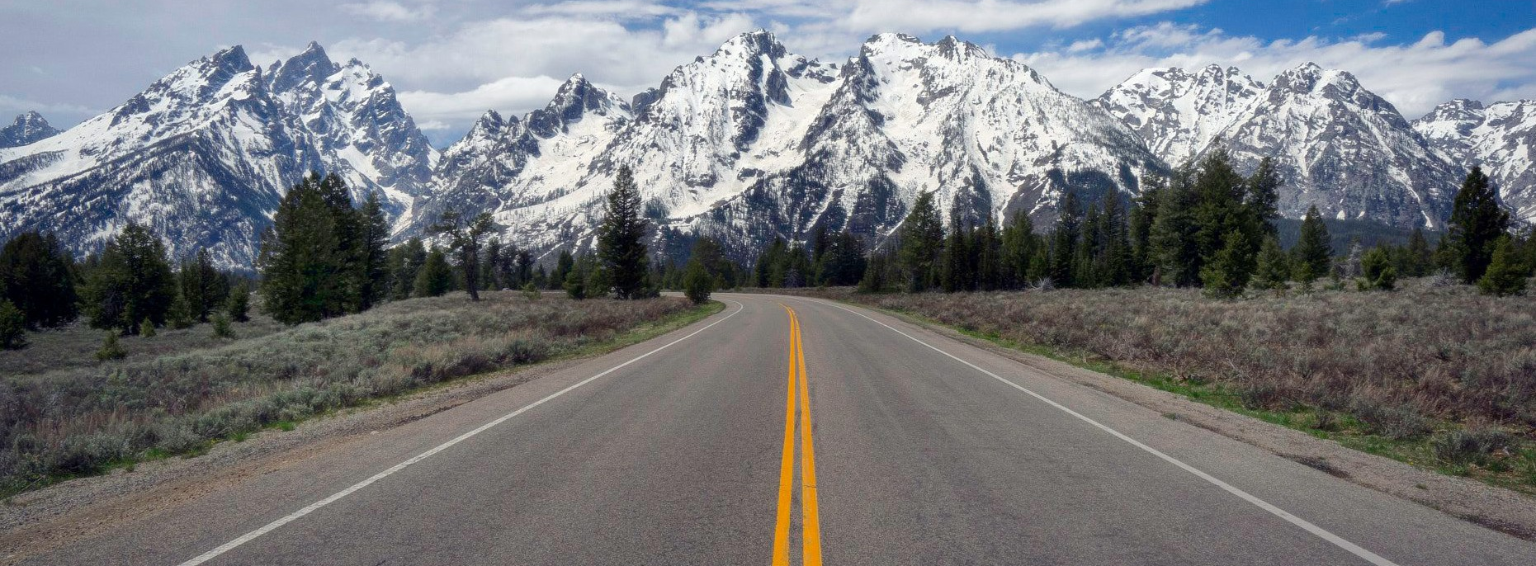
Renovation Completion Fall 2024

Slide 2
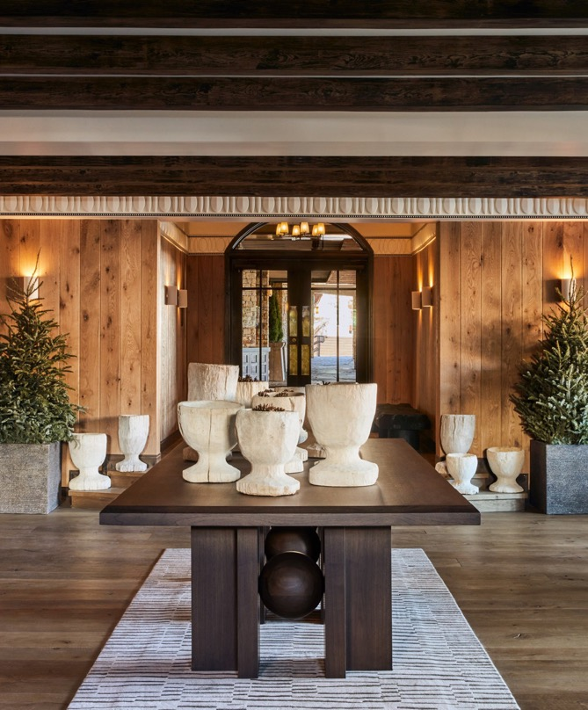
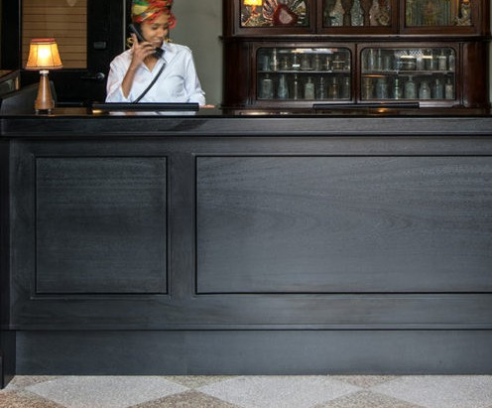
RECEPTION
Guests will step into Omni Interlocken Resort and be greeted by a blend of sophisticated and timeless textures, cozy layers of warmth, a touch of playfulness, and design elements that honor the great outdoors.

Slide 3
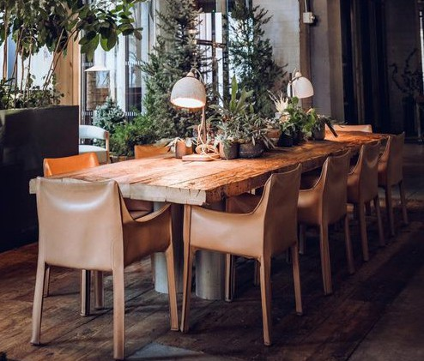
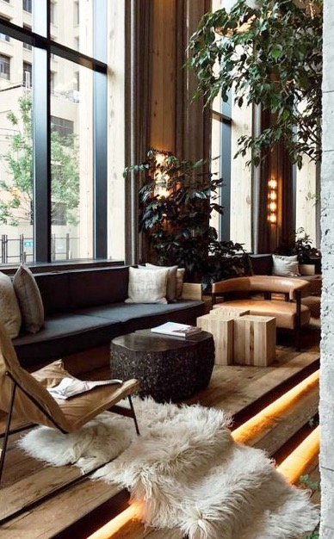
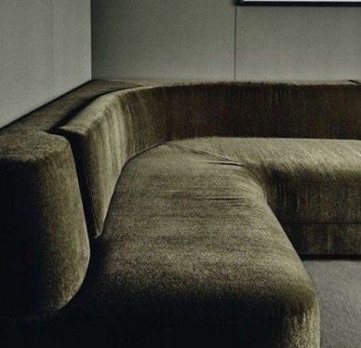
LOBBY LOUNGE
An inviting and cozy lounge beckons guests to relax within its warm ambiance, featuring elements like a rustic wood slat fireplace, communal tables and banquet seating,
televisions and more.

Slide 4
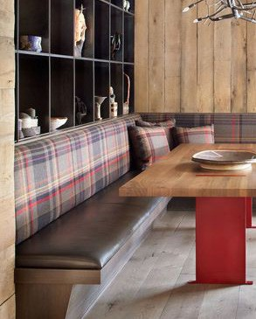
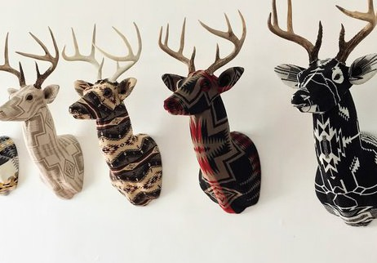
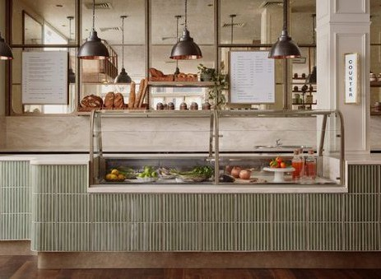
COFFEE SHOP
The renovated coffee shop will be just off the lobby and include:
Full range of coffee, tea and pastries
Grab & go cold case
Retail displays highlighting local artisans
Banquet seating

Slide 5
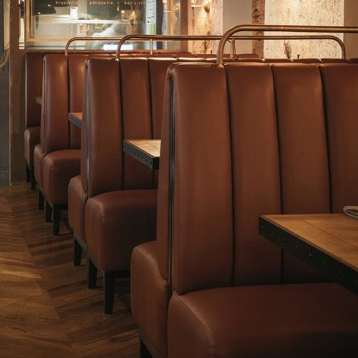
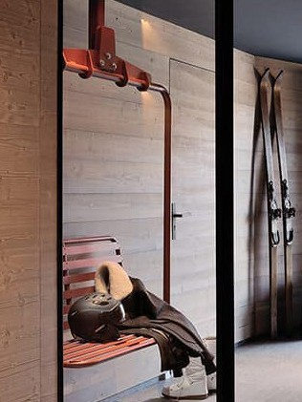
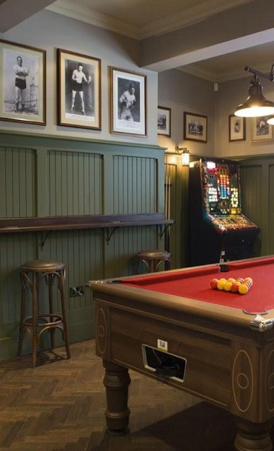
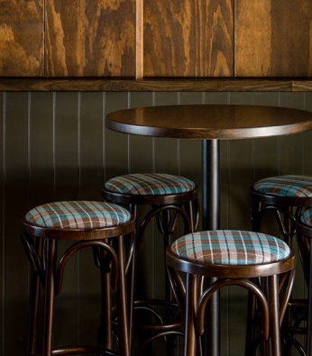
TAP ROOM
The Tap Room offers visitors a laid-back mountain-chic dining experience, allowing them to relish the distinctive tastes of Colorado.
Guests will also be able to enjoy a dedicated gaming area for added entertainment.

Slide 6
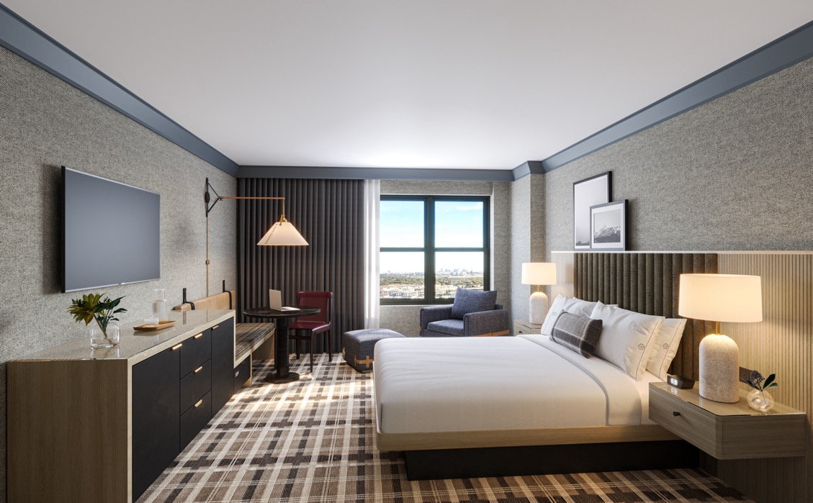
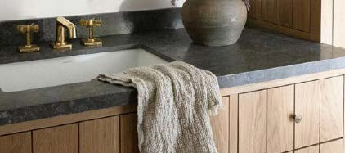
DELUXE & PREMIER ROOMS
300 square feet of living space accented with leather textures, playful artwork and design that honors the great outdoors
Bench with storage underneath for all adventure gear from hiking to skiing
Activity table that serves as a multi purpose desk for working, games and dining
Bathroom featuring Colorado inspired wall coverings, oil rubbed bronze, polished chrome and black accents

Slide 7
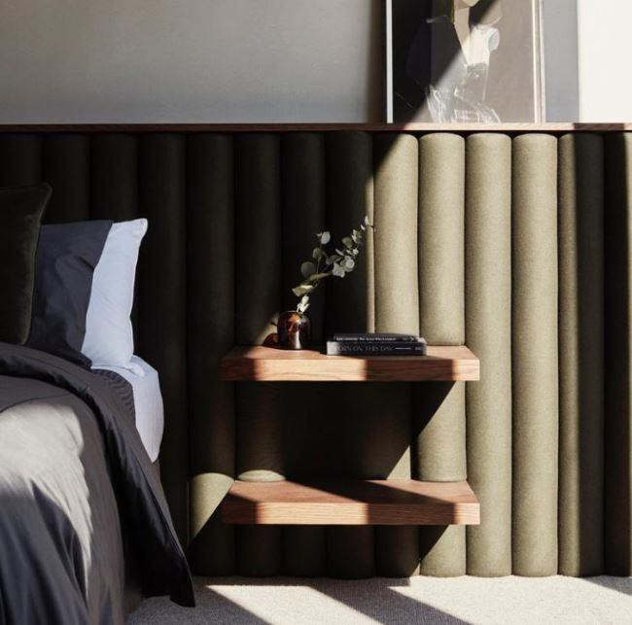
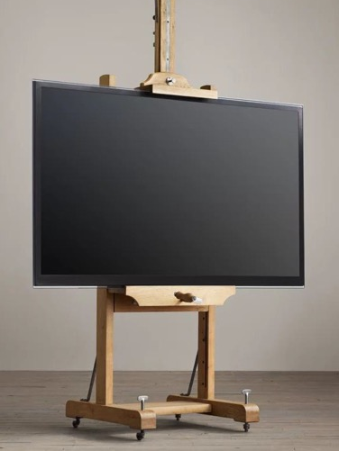
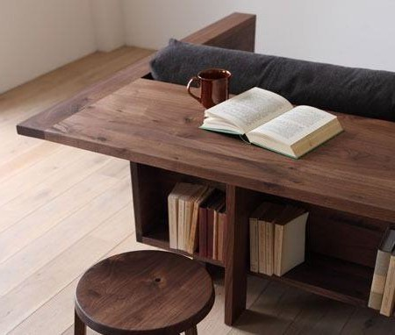
1 BEDROOM SUITE
The one bedroom suite is a rustic, tailored and refined space that offers breathtaking views of the Rocky Mountains or golf course. Featuring a distinct separation between the bedroom and living room, the suite also includes a convenient wet bar.
590 square feet of living space
Pocket doors that separate the bedroom and living room
Sectional sleeper sofa with queen pull out

